Slide 1

SRM Institute of Science and Technology
School of Computing
DEPARTMENT OF NETWORKING AND COMMUNICATIONS
Kattankulathur – 603203, Chengalpattu, Tamilnadu
A Secure Data Dynamics and Public Auditing Scheme for Cloud Storage
18CSP107L -Minor Project
RA2011028010069 - D.BHARGAV
RA2011028010083 - UPANSHU BHARDWAJ
Batch ID:NWC038
Guide name and Designation:
Dr.Saravanan M- Associate Professor, NWC

Slide 2
INDEX
Abstract
Objective of project
Problem Statement
Scope & Motivation
Introduction
Literature survey
Existing Method
Disadvantages
Proposed method
Advantages
Project Flow
Hardware and Software Requirements
Architecture
Modules
UML Diagram
Output Screens
Conclusion
Future Work
References

Slide 3
ABSTRACT
Cloud computing is an evolving technology that provides data storage and highly fast computing services at a very low cost. All data stored in the cloud is handled by their cloud service providers or the caretaker of the cloud. The data owner is concerned about the authenticity and reliability of the data stored in the cloud as the data owners. Data can be misappropriated or altered by any unauthorized user or person. This paper desire to suggest a secure public auditing scheme applying third party auditors to authenticate the privacy, reliability, and integrity of data stored in the cloud. This proposed auditing scheme composes the use of the AES-256 algorithm for encryption, SHA-512 for integrity check and RSA-15360 for public key encryption. And perform data dynamics operation which deals with mostly insertion, deletion, and, modification.
KEYWORDS: TPA, CSS, Data owner, Upload file, Accept Request, Generate Key, Download File.

Slide 4
OBJECTIVE OF PROJECT
The objective of this project is to develop a robust and efficient data dynamics and public auditing scheme for cloud storage. The scheme aims to ensure the security and integrity of data in the cloud, while also allowing authorized users to dynamically modify the stored data. Additionally, the project seeks to enable public auditing, allowing third-party auditors to verify data integrity without accessing the actual content. By achieving these objectives, the proposed scheme enhances the trustworthiness and accessibility of cloud storage services, addressing crucial concerns regarding data privacy and security in cloud computing environments

Slide 5
PROBLEM STATEMENT
A Secure Data Dynamics and Public Auditing Scheme for Cloud Storage is a novel approach aimed at addressing the challenges of data integrity, confidentiality, and public auditing in cloud storage environments. The proposed scheme ensures that data stored in the cloud remains secure, and enables authorized users to perform dynamic operations like data insertion, modification, and deletion while preserving data privacy. Additionally, it incorporates a public auditing mechanism, allowing third-party auditors to verify data integrity without accessing the actual content. The scheme employs advanced cryptographic techniques to achieve these objectives, including homomorphism encryption, signature-based authentication, and hash functions. By combining data dynamics, privacy preservation, and public auditing capabilities, this scheme enhances cloud storage security, promotes data accountability, and builds trust among cloud service providers and their clients.

Slide 6
SCOPE
Scope:- The scope of "A Secure Data Dynamics and Public Auditing Scheme for Cloud Storage" involves developing a robust system for dynamic data operations (e.g., update, delete) and ensuring data integrity and security in cloud storage. Additionally, it enables public auditing to allow external entities to verify data integrity without compromising privacy.

Slide 7
INTRODUCTION
The global cloud computing market is anticipated to rise from $272billion in 2018 to $624billion by 2023 at a compound annual growth rate of 18%, a report from research and markets showed. Cloud computing is an advanced technology every person is used inner or outer in today’s world [2]. The advance and rapidly expanding technology of cloud computing are used computation and storage. The very minimum cost is used storage and computation as a service in it. Service model provided three essential services in it: infrastructure as a service (IaaS), platform as a service (PaaS) and software as a service(SaaS)[3]. The NIST definition, “Cloud computing is a model permissive ubiquitous, convenient, on-demand network approach to a shared pool of configurable computing property(e.g. networks, servers, storage, applications, and services) that can be immediately provisioned and released with basic management effort or service provider interaction [4][6]. Cloud storage is a crucial service of cloud computing[5]. They involve data privacy, data protection, data availability, data location, and, secure transmission which is a crucial release in cloud security. The involved in cloud. challenge security are threats, data loss, degradation, outside malicious attack and multi-tenancy [6]. The stored information of integrity is conserved for data integrity in the cloud system. The unauthorized users should not be accessed misappropriate or vary of data. Data integrity and reliability of data are faithful to preserve by the cloud computing provider.

Slide 8
INTRODUCTION
Data confidentiality is also a crucial way from a user’s point of perspective therefore they store their private or confidential data in the cloud. Data confidentiality is taken to assure access control policies and authentication. The faith of cloud computing could be forward by rising cloud authenticate and data confidentiality. So the keep data on the cloud should be security, integrity, privacy, and confidentiality of crucial demands from the user perspective. A secure data storage of cloud computing is presented of a data auditing scheme. Auditing is a refinement of checking the user data which can be done by the data owner or by a TPA[8]. The integrity of stored data on the cloud serves to maintain it. The TPA manage is split into two: one is private audibility, which allows the data owner can analyze the integrity of the data. No one has the authority to inquire about the server considering the data[8].
.

Slide 9
LITERATURE REVIEW
S NO | TITLE OF THE PAPER | PUBLISH YEAR | AUTHOR | ISSUES ADDRESSED | TOOLS& LANGUAGES USED
1 | Secure Cloud Storage with Deduplication Technique 2020 | 2021 | R. Patil Rashmi; Yatin Gandhi; Vinaya Sarmalkar | Deduplication on client side cannot be given a new hash tag when updation of file is done. Hence, dynamic ownership fails | homomorphic hash algorithm, RDPC protocol, C++,
2 | Secured File Storage in Cloud Computing Application: Secure-Drive 2021 | 2021 | Nidhi Nair; Tanuj Jain; Mihir Gada | Secure Transmission Protecting files during upload and download by using secure communication protocols like HTTPS and ensuring data remains confidential during transit. | Html, Css, Blowfish and TripleDES, Phyton .
3 | TPA Auditing to Enhance the Privacy and Security in Cloud Systems | 2020 | Sunil Kumar, Dilip Kumar, Hemraj Lamkuche | More cost , Time taking process.It need future development to reach the public auditing. | CSL and BLAKE3 hash algorithm,C++ Amazon S3,

Slide 10
LITERATURE REVIEW
S NO | TITLE OF THE PAPER | PUBLISHED YEAR | AUTHOR | ISSUES ADDRESSED | TOOLS& LANGUAGES USED
4 | A Real Time Auditing System using QR Code for Secure Cloud Storage 2020 | 2020 | P. Baby Shamini; D. C. Joy Winnie Wise; K. S. Megavarshini. | Concurrency Control ,Mobile Device Considerations. | HTML , CSS ,Python , Apache MariaDB
5 | A Design for Scalable and Secure Key-Value Stores. | 2017 | Longbin Chen; Wenyun Dai. | As querying language is not present in key-value databases, transportation of queries from one database to a different database cannot be done | flash memories, Python,Amazon Dynamo and Google BigTable.
6 | Orchini Similarity User Authentication Based Streebog Hash Function for Secured Data Storage in Cloud | 2020 | P. Calista Bebe, Akila D. | High implementaton cost, If the number of owners increases it maximize the computation time | Amazon EC2 dataset, OSA-SHSDS

Slide 11
LITERATURE REVIEW
S NO | TITLE OF THE PAPER | PUBLISHED YEAR | AUTHOR | ISSUES ADDRESSED | TOOLS& LANGUAGES USED
7 | An efficient auditing scheme for data storage security in cloud | 2017 | J Agarkhed, R Ashalatha | In this paper, we propose an efficient auditing system for fog-to-cloud computing. Although our system is not public auditing | OpenSSL, CloudSim, Cloud Service Providers (CSP) APIs
8 | Third Party Public Auditing on Cloud Storage using the Cryptographic Algorithm | 2017 | B.L Adokshaja, and S.J.Saritha | An efficient and securable privacy preserving public auditing scheme is been proposed. It achieves privacy preserving and public auditing The data is split into parts and then stored in the in the cloud storage | Secure Hash Algorithm, Python, Network Security Tools
9 | Cloud Server Storage Security using TPA | 2014 | IK Meenakshi and Sudha George | The process such as the data owner can check the integrity of their data stored in cloud server using TPA which can be done inefficient manner | Django (Python), Ruby on Rails (Ruby), MongoDB, MySQL

Slide 12
EXISTING METHOD
All data stored in the cloud is handled by their cloud service providers or the caretaker of the cloud. The data owner is concerned about the authenticity and reliability of the data stored in the cloud as the data owners. Data can be misappropriated or altered by any unauthorized user or person.

Slide 13
DIS ADVANTAGES
1. Complexity: Implementing a secure data dynamics and public auditing scheme for cloud storage can be complex and require significant expertise in cryptography and security. This complexity can lead to potential vulnerabilities if not properly designed and implemented.
2. Performance Overhead: Adding security measures and auditing mechanisms can introduce performance overhead, potentially impacting data access and retrieval times. This can be particularly concerning for cloud storage, where users expect fast and seamless access to their data.
3. Resource Consumption: Public auditing schemes may require additional computational resources, such as CPU cycles and memory, to carry out auditing and verification tasks. This increased resource consumption could result in higher costs for cloud service providers and users

Slide 14
DIS ADVANTAGES
4. Key Management: Ensuring the security and integrity of encryption keys and auditing tokens is crucial in any secure cloud storage scheme. Key management can be challenging and prone to human errors, potentially leading to security breaches.
5. Privacy Concerns: Public auditing schemes, by their nature, involve third-party verification of data integrity, which could raise privacy concerns for some users. Users might be hesitant to have their data audited by external parties, even if it is for security purposes.

Slide 15
PROPOSED METHOD
This proposed auditing scheme composes the use of the AES-256 algorithm for encryption, SHA-512 for integrity check and RSA-15360 for public key encryption. And perform data dynamics operation which deals with mostly insertion, deletion, and, modification.

Slide 16
ADVANTAGES
1. Data Confidentiality: By encrypting each operation and the data itself, the sensitive information remains confidential and protected from unauthorized access. Only authorized users with the proper decryption keys can access the data.
2. Data Integrity: The use of encryption ensures the integrity of the data. Any unauthorized modifications or tampering attempts can be detected since the encrypted data will not match the expected values during decryption.
3. Secure Data Operations: Users can perform various operations on their data securely, including modifications, deletions, and append operations. The encryption ensures that these operations are performed securely without compromising the data's privacy or integrity.

Slide 17
ADVANTAGES
4. Accountability and Auditability: Public auditing mechanisms allow for the verification and accountability of data operations. Each operation is recorded in encrypted form, enabling auditing for detecting any unauthorized changes or discrepancies in the data.
5. Trust and Compliance: The combination of secure data dynamics and public auditing enhances trust in cloud storage systems. It helps meet compliance requirements for data security, privacy, and regulatory standards, as the system provides mechanisms for data protection and accountability.
6. Versatility: The approach can be applied to text data of various formats and sizes, making it applicable to a wide range of applications and use cases.

Slide 18
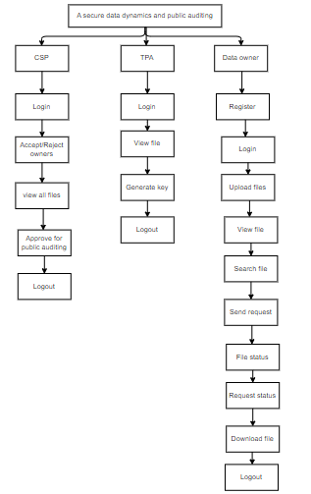
PROJECT FLLOW
Figure: work Flow of Proposed system

Slide 19
HARDWARE AND SOFTWARE REQUIREMENTS
H/W System Configuration:-
Processor - I3/Intel Processor
RAM - 4GB (min)
Hard Disk - 160GB
Key Board - Standard Windows Keyboard
Mouse - Two or Three Button Mouse
Monitor - SVGA

Slide 20
HARDWARE AND SOFTWARE REQUIREMENTS
S/W System Configuration:-
Operating System : Windows 7/8/10
Application Server : Tomcat 7.0
Front End : HTML, JSP
Scripts : JavaScript.
Server side Script : Java Server Pages.
Database : My SQL 6.0
Database Connectivity : JDBC

Slide 21
FUNCTIONAL AND NON-FUNCTIONAL REQUIREMENTS
Requirement’s analysis is very critical process that enables the success of a system or software project to be assessed. Requirements are generally split into two types: Functional and non-functional requirements.
Functional Requirements: These are the requirements that the end user specifically demands as basic facilities that the system should offer. All these functionalities need to be necessarily incorporated into the system as a part of the contract. These are represented or stated in the form of input to be given to the system, the operation performed and the output expected. They are basically the requirements stated by the user which one can see directly in the final product, unlike the non-functional requirements.

Slide 22
FUNCTIONAL AND NON-FUNCTIONAL REQUIREMENTS
Examples of functional requirements:
Authentication of user whenever he/she logs into the system
System shutdown in case of a cyber-attack
A verification email is sent to user whenever he/she register for the first time on some software system.
Non-functional requirements: These are basically the quality constraints that the system must satisfy according to the project contract. The priority or extent to which these factors are implemented varies from one project to other. They are also called non-behavioral requirements.

Slide 23
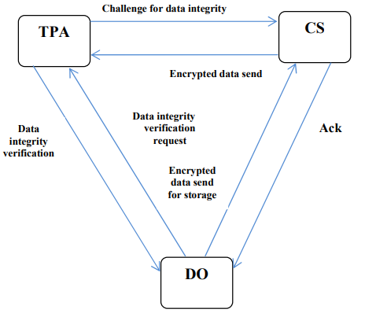
ARCHITECHTURE

Slide 24
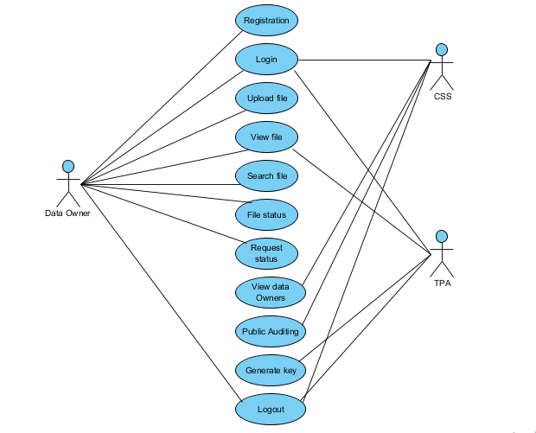
UML DIAGRAMS
Figure: Use Case Diagram

Slide 25
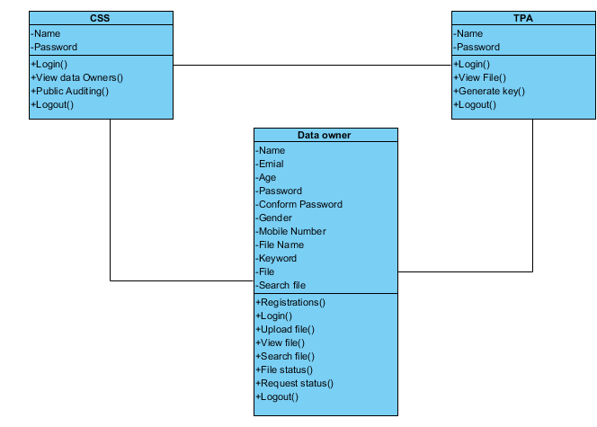
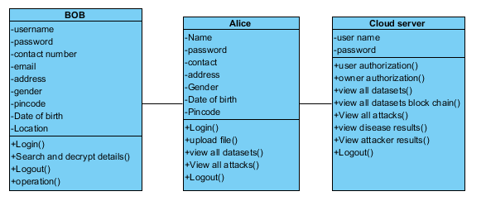
UML DIAGRAMS
Figure: Class diagram

Slide 26
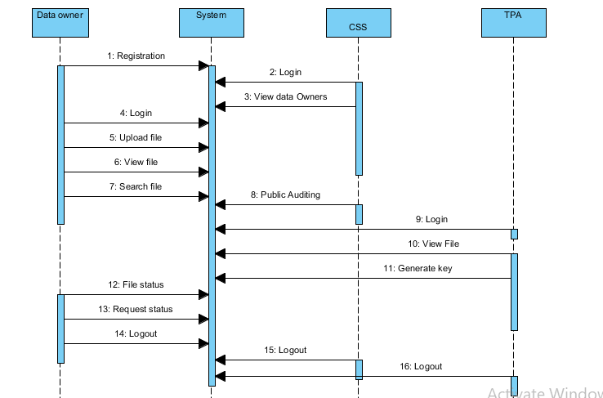
UML DIAGRAMS
Figure: Sequence diagram

Slide 27
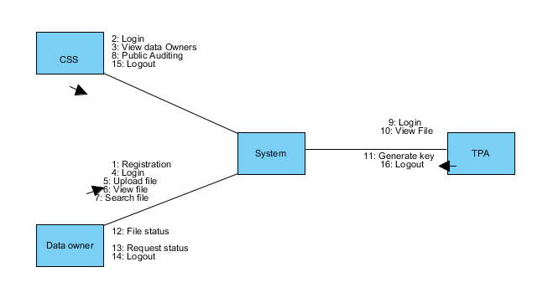
UML DIAGRAMS
Figure: Collaboration diagram

Slide 28
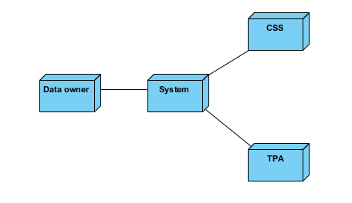
UML DIAGRAMS
Figure: Deployment diagram

Slide 29
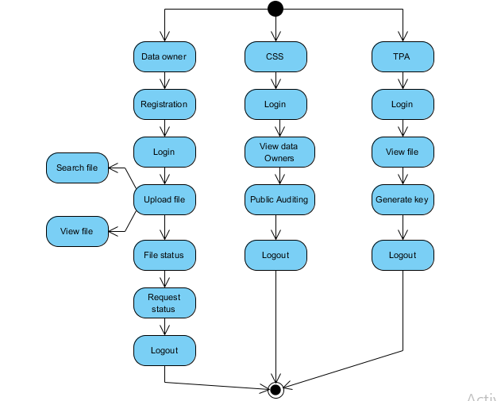
UML DIAGRAMS
Figure: Activity diagram

Slide 30
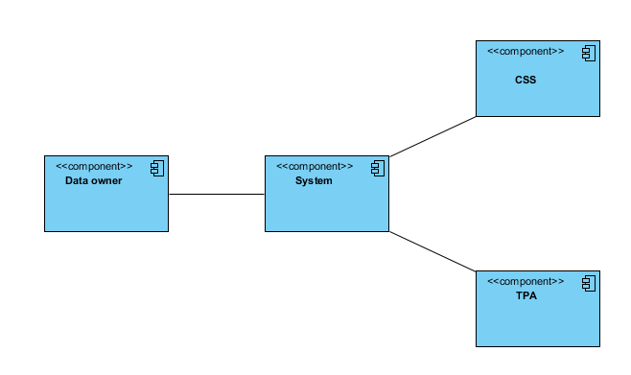
UML DIAGRAMS
Figure: Component diagram

Slide 31
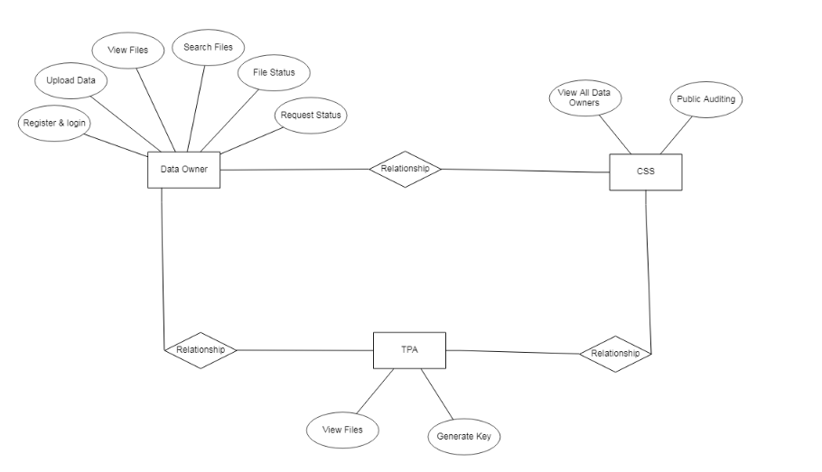
UML DIAGRAMS
Figure: ER diagram

Slide 32
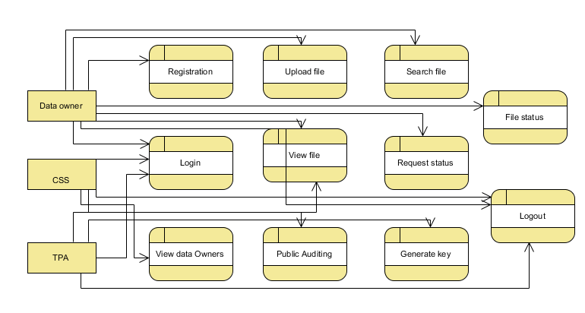
UML DIAGRAMS
FigureLevel-1 diagram

Slide 33
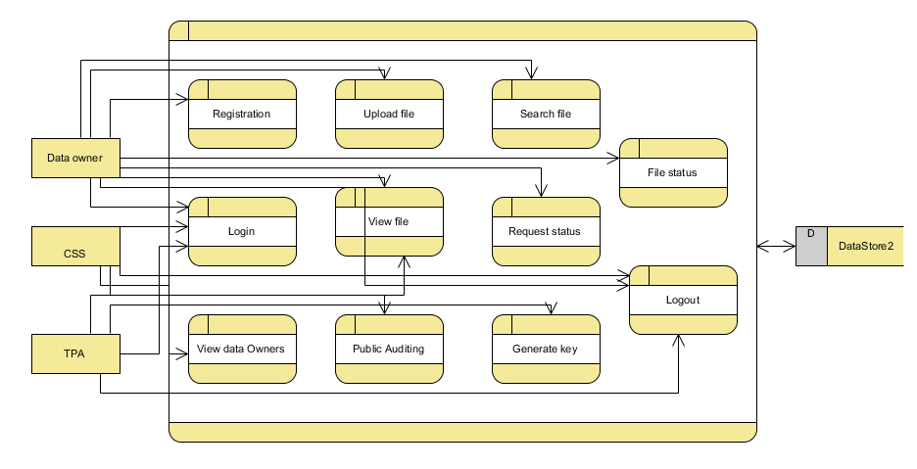
UML DIAGRAMS
Figure:Level-2 diagram

Slide 34
MODULES/IMPLEMENTATION
1. DATA OWNER:
Register:
Data owner can Register and login with valid credentials
Upload File:
Data provider can upload the file.
View File:
Data Owner can view uploaded file once means whether the file is correctly uploaded or not.
Search a File:
Data user can search a file based on the keyword, if file is available then user can view file and send request to cloud to download the file.
View File Status: The person who is sending request he /she can view the status of that file.
Request Status: After accepting the request from the cloud and TPA.

Slide 35
MODULES/IMPLEMENTATION
2. Cloud Provider
Login
Cloud provider can login with his/her credentials.
View Files:
Cloud can view all uploaded files.
View Data owner:
Cloud can view all the data owner details to give permission for login the website.
Approve for public Auditing:
Cloud gets a key from Owner and send to the TPA.
3. Third party Authority:
Login: Third party Authority login and view give authorization to owners.
Generate key to users: Authority generate key to particular file to a particular owner

Slide 36
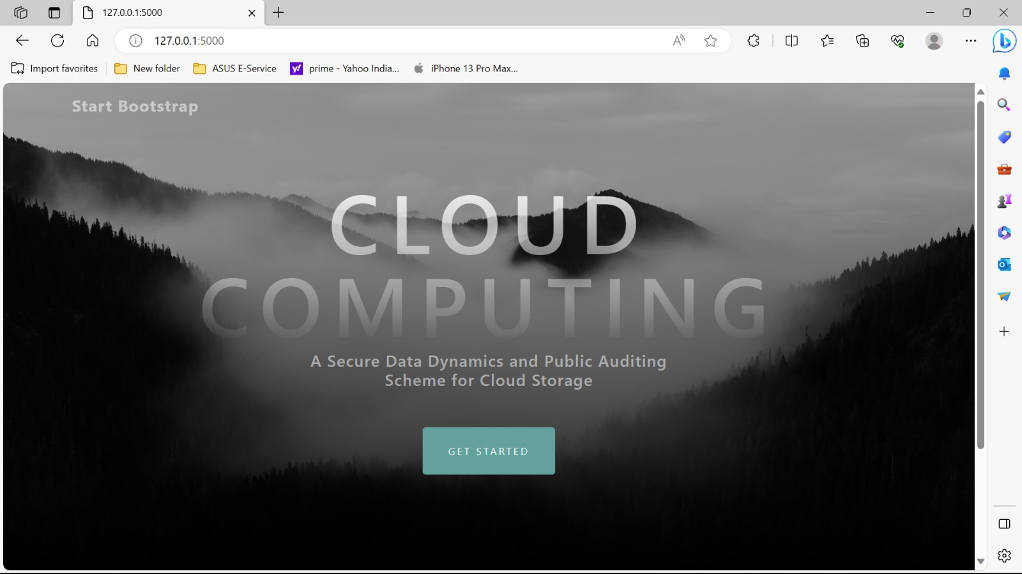
OUTPUT SCREENS
Home page: A Secure Data Sharing and Authorized Searchable Framework for e-Healthcare System home page.

Slide 37
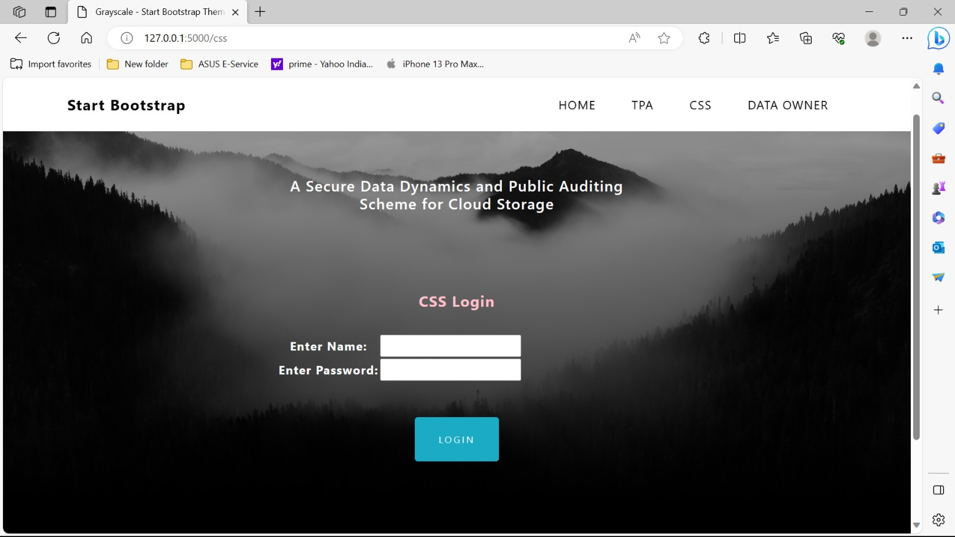
OUTPUT SCREENS
Alice login page: After registration the alice can login with email and password.

Slide 38
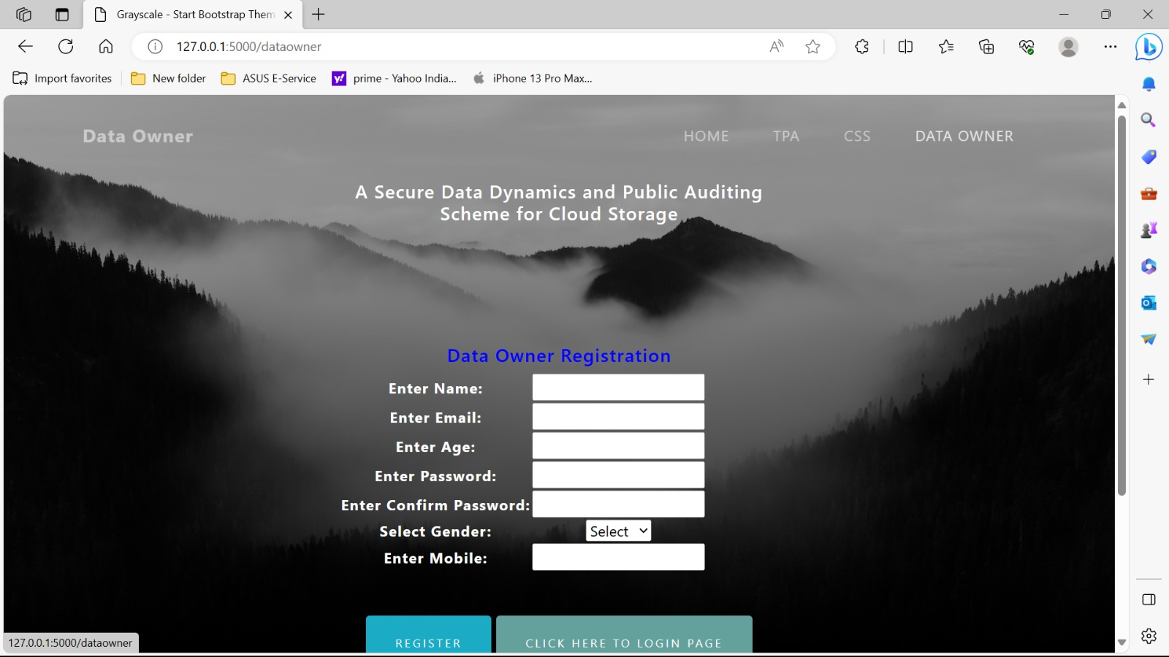
OUTPUT SCREENS
Alice registration page: The alice will register with the details like name, email, password, contact, address,
gender, DOB, pin code, and location.

Slide 39
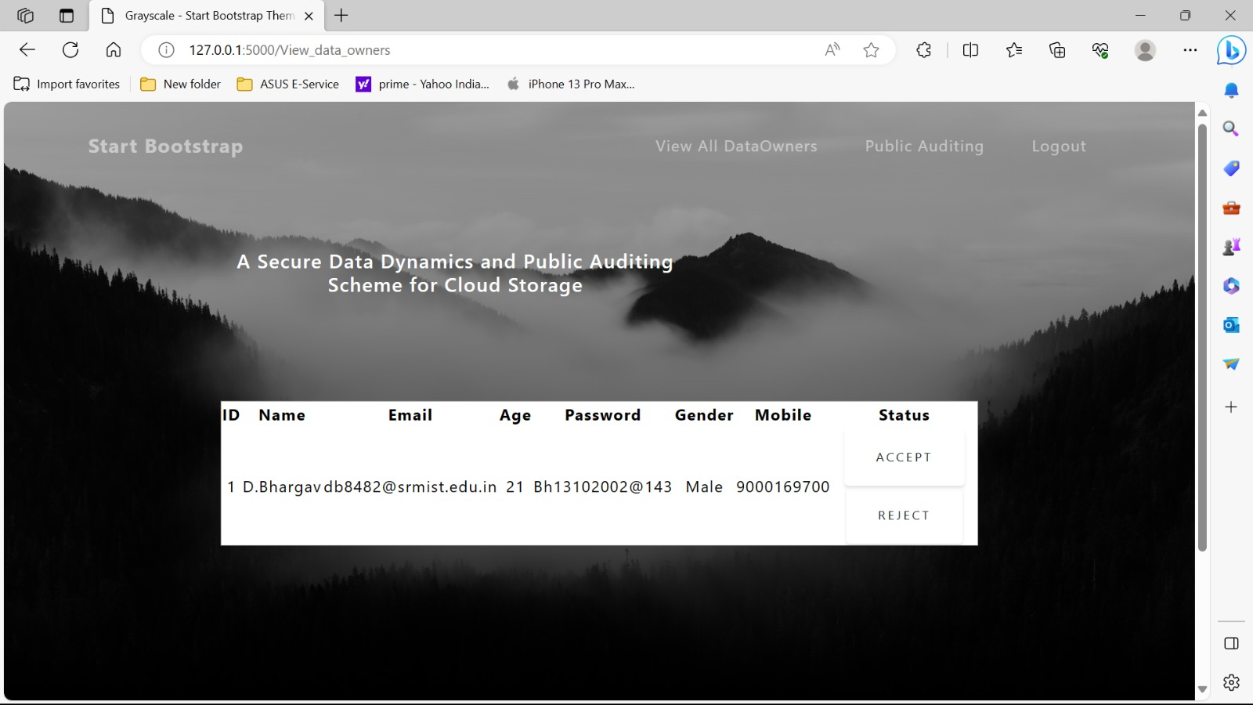
OUTPUT SCREENS
Upload file: After login the alice will upload the file

Slide 40
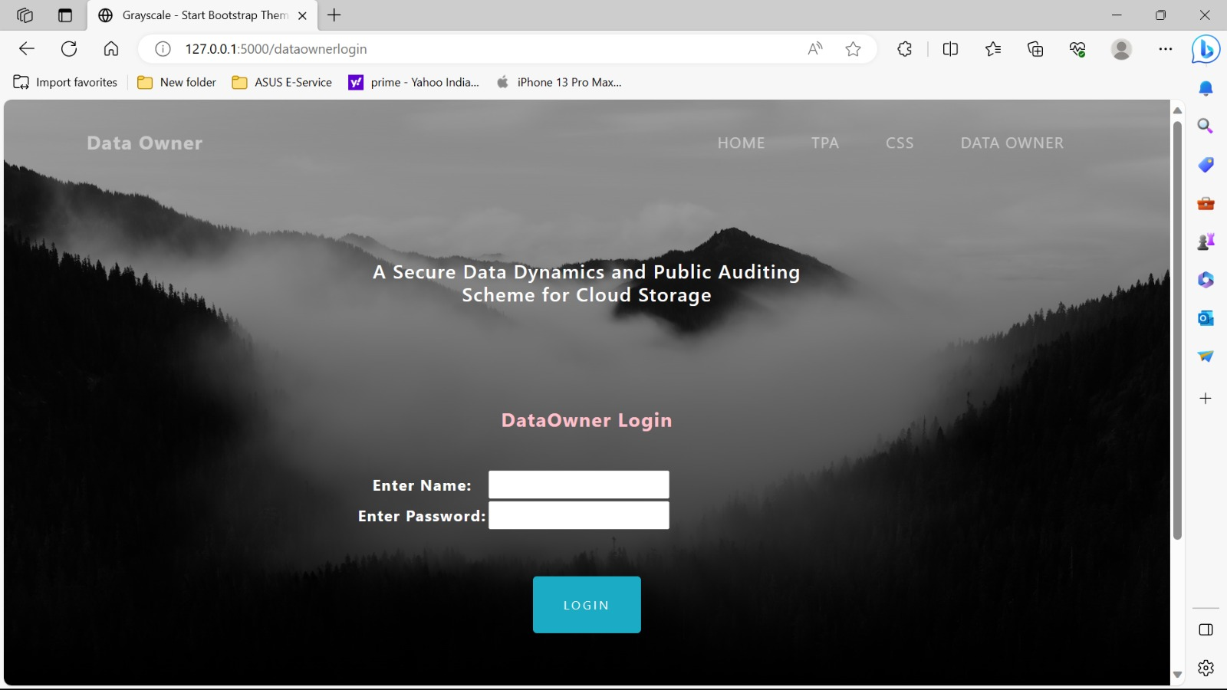
OUTPUT SCREENS
Owner login page: owner will login after registration.

Slide 41
OUTPUT SCREENS
Owner registration page: The Owner will register with the details like name, email, password, contact,
gender,

Slide 42
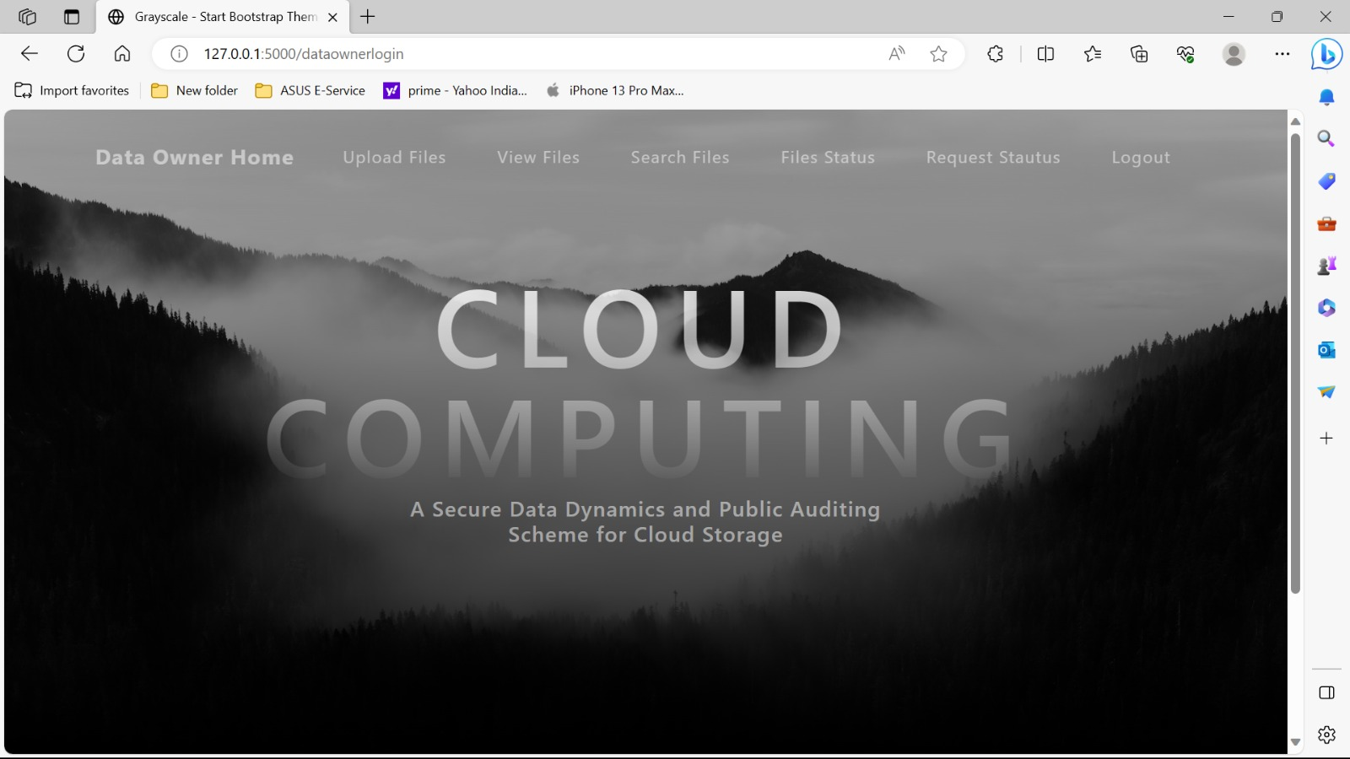
OUTPUT SCREENS
owner home page: After login the owner will enter into the homepage.

Slide 43
OUTPUT SCREENS
CSS login page: CSS can login with Name and password.

Slide 44
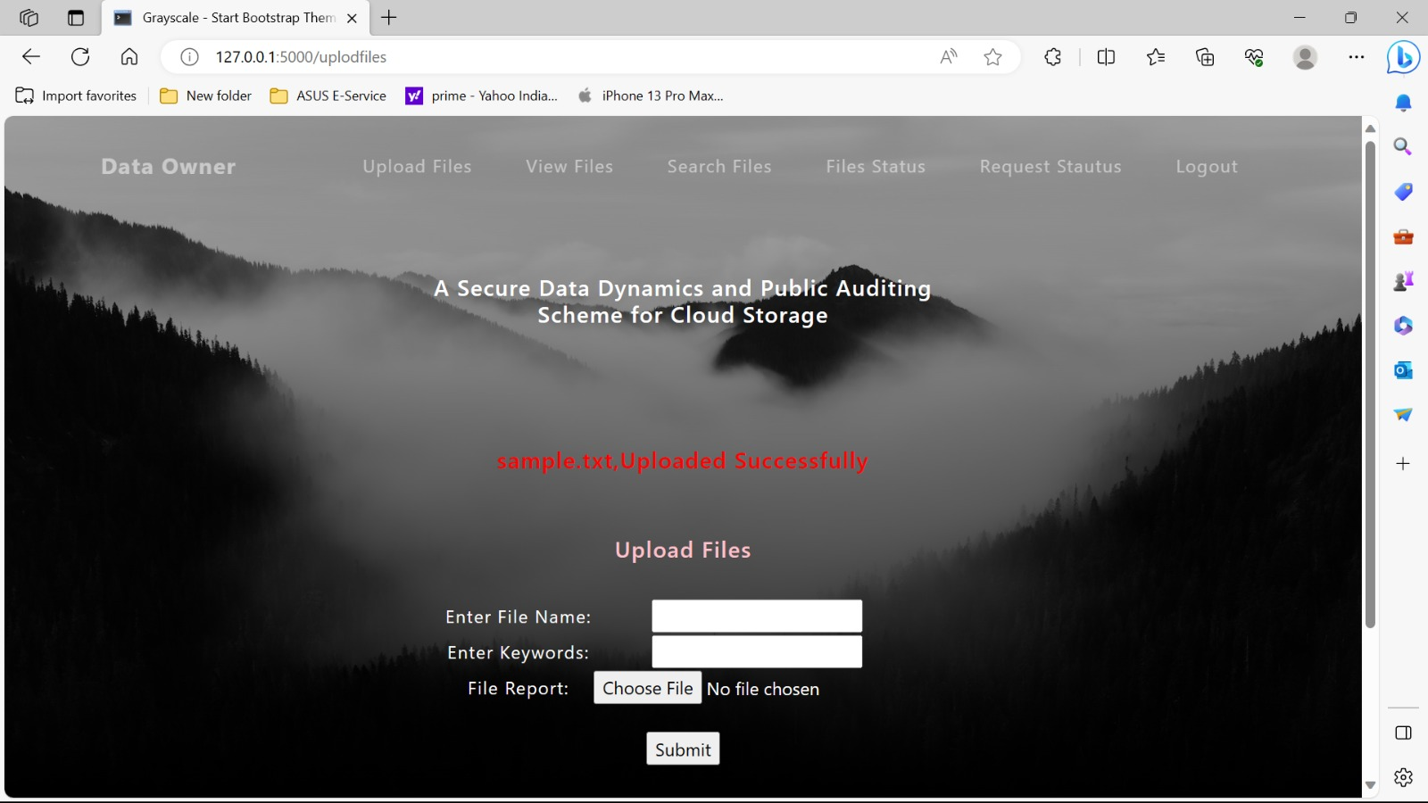
OUTPUT SCREENS
Owner : After login the owner can upload the file.

Slide 45
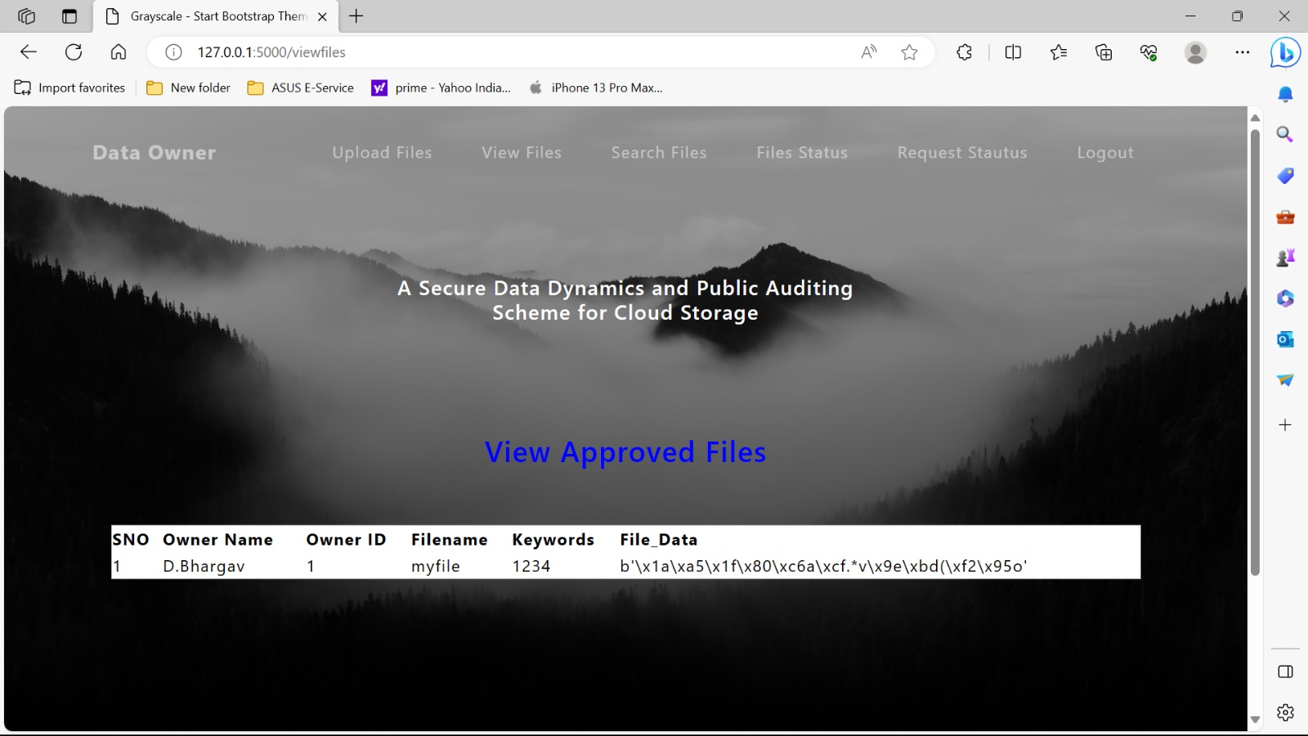
OUTPUT SCREENS
File data uploaded by the data owner 1 has been encrypted

Slide 46
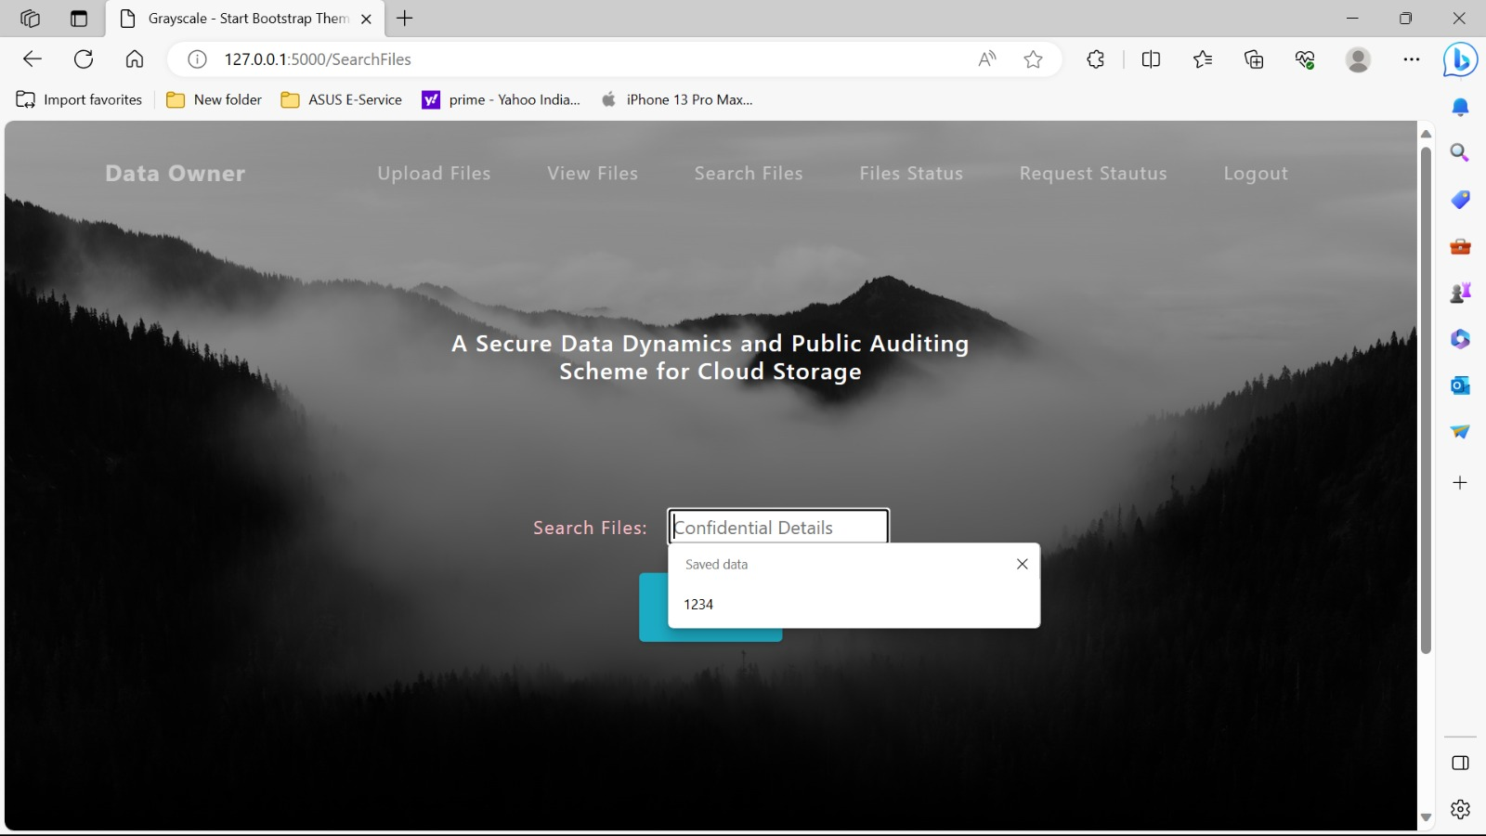
OUTPUT SCREENS
Data owner 2 is searching for a data uploaded by the owner 1 with unique file name.

Slide 47

OUTPUT SCREENS
TPA login page .

Slide 48
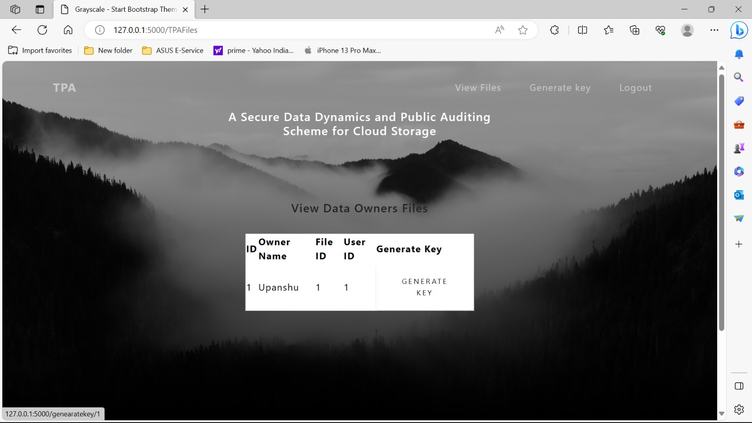
OUTPUT SCREENS
TPA generating key for data owner 2.

Slide 49
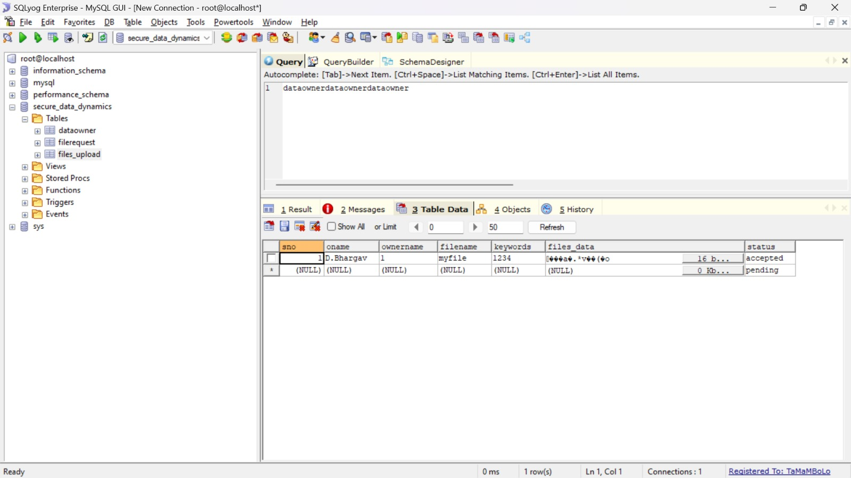
OUTPUT SCREENS

Slide 50
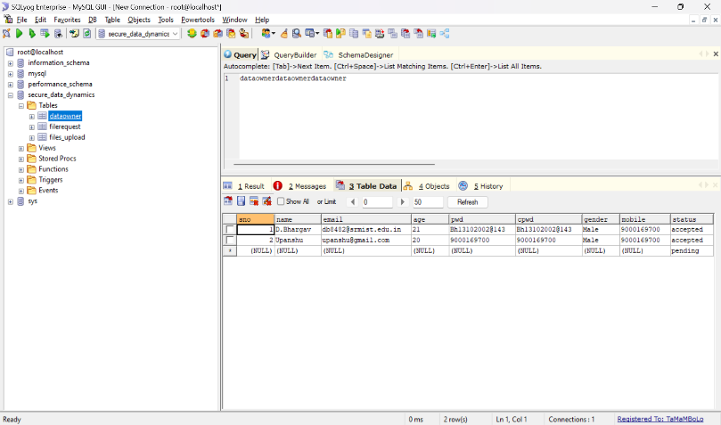
OUTPUT SCREENS

Slide 51
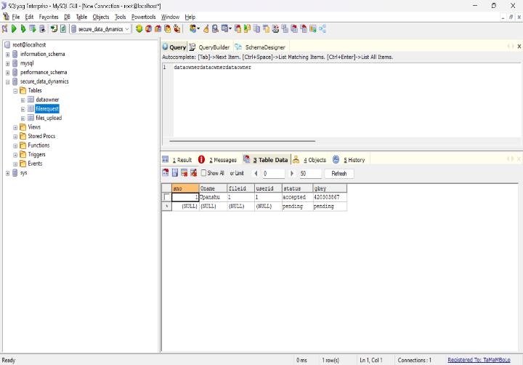
OUTPUT SCREENS

Slide 52
CONCLUSION:
A secure auditing method is to store the data on the cloud in a secure manner. The prospective take the AES-256 algorithm, RSA-15360, and SHA-512 algorithm to assure that TPA cannot knowledge about data toward the robustness auditing scheme. We propose a data dynamics operation with mostly deal insertion, deletion and, modification.

Slide 53
REFERENCES:
Secure Cloud Storage with Deduplication Technique 20202021
R. Patil Rashmi; Yatin Gandhi; Vinaya Sarmalkar
Secured File Storage in Cloud Computing Application: Secure-Drive 2021
Nidhi Nair; Tanuj Jain; Mihir Gada
TPA Auditing to Enhance the Privacy and Security in Cloud Systems 2020
Sunil Kumar, Dilip Kumar, Hemraj Lamkuche
A Real Time Auditing System using QR Code for Secure Cloud Storage 2020
P. Baby Shamini; D. C. Joy Winnie Wise; K. S. Megavarshini.
A Design for Scalable and Secure Key-Value Stores. 2017 Longbin Chen; Wenyun Dai.
Orchini Similarity User Authentication Based Streebog Hash Function for Secured Data Storage in Cloud
2020 P. Calista Bebe, Akila D.

Slide 54
The global cloud computing market report 2019.
J Agarkhed, R Ashalatha-”An efficient auditing schheme for data storage security in cloud”.2017[ICCPCT].
SK Saroj, G Noida,SK Chauhan, AK Sharma “Threshold cryptography based data security in cloud computing”. S Vats-2015.
Mell, Peter, and Tim Grance.The NIST definition of cloud computing(2011).
P.Mell and T.Grance, ”The NIST definition of cloud computing”, National Institute of Standards and Technology, Tech. Rep.,2009.

Slide 55
Swapnali Morea, Sangita Chaudhari, ”Third Party Public Auditing Scheme for Cloud Storage “,International Journal of Prpcedia Computer Science ,Volume 79,pp.69-76,2016.
Zissis, Dimitrios, and Dimitrios Lekkas. Addressing cloud computing security issues. Future Generation computer systems 28.3(2012):583-592.
B.L Adokshaja, and S.J.Saritha, ”Third Party Public Auditing on Cloud Storage using the Cryptographic Algorithm”ICECDS-2017.
Cong Wang, Sherman SM Chow, Qian Wang, Kui Ren, and Wenjing Lou.”Privacy Preserving Public Auditing for Secure Cloud Storage. http://eprint.iacr.org/2009/579.pdf.
Cong Wong, Sherman S M Chow, Qian Wang, Kui Ren, and Wen jing Lou. “Privacy Preserving Public Auditing for Secure Cloud Storage”. IEEE Transactions on Computers, Volume 62, ISSUE 2, February 2013

